Slide 1
Unfold
Presentation for Topic A
Group 14

Slide 2
Method

Slide 3
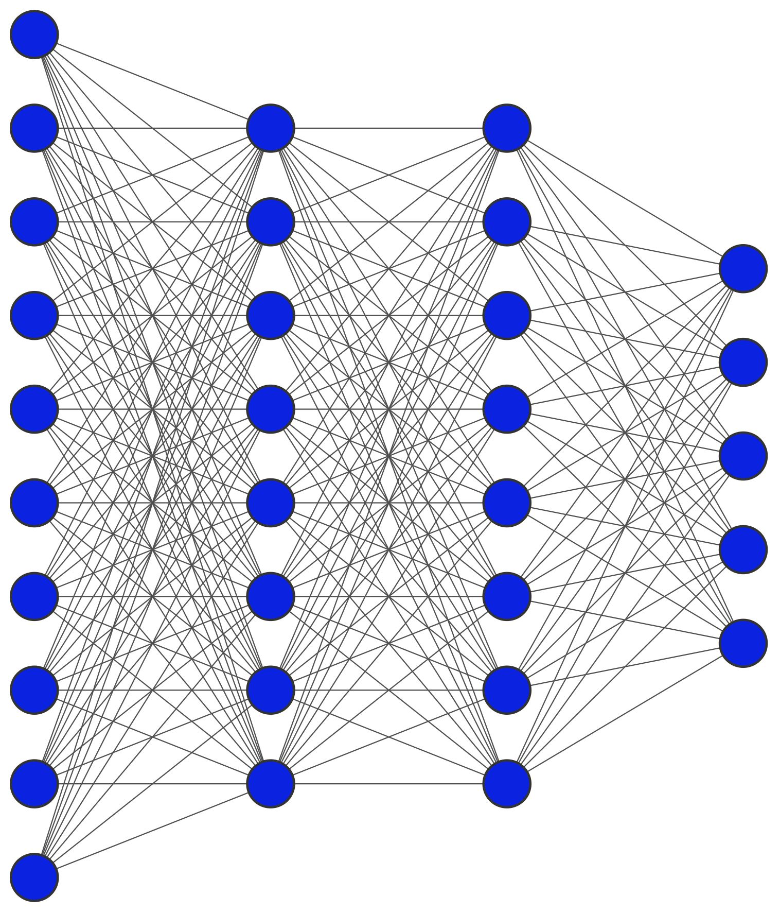
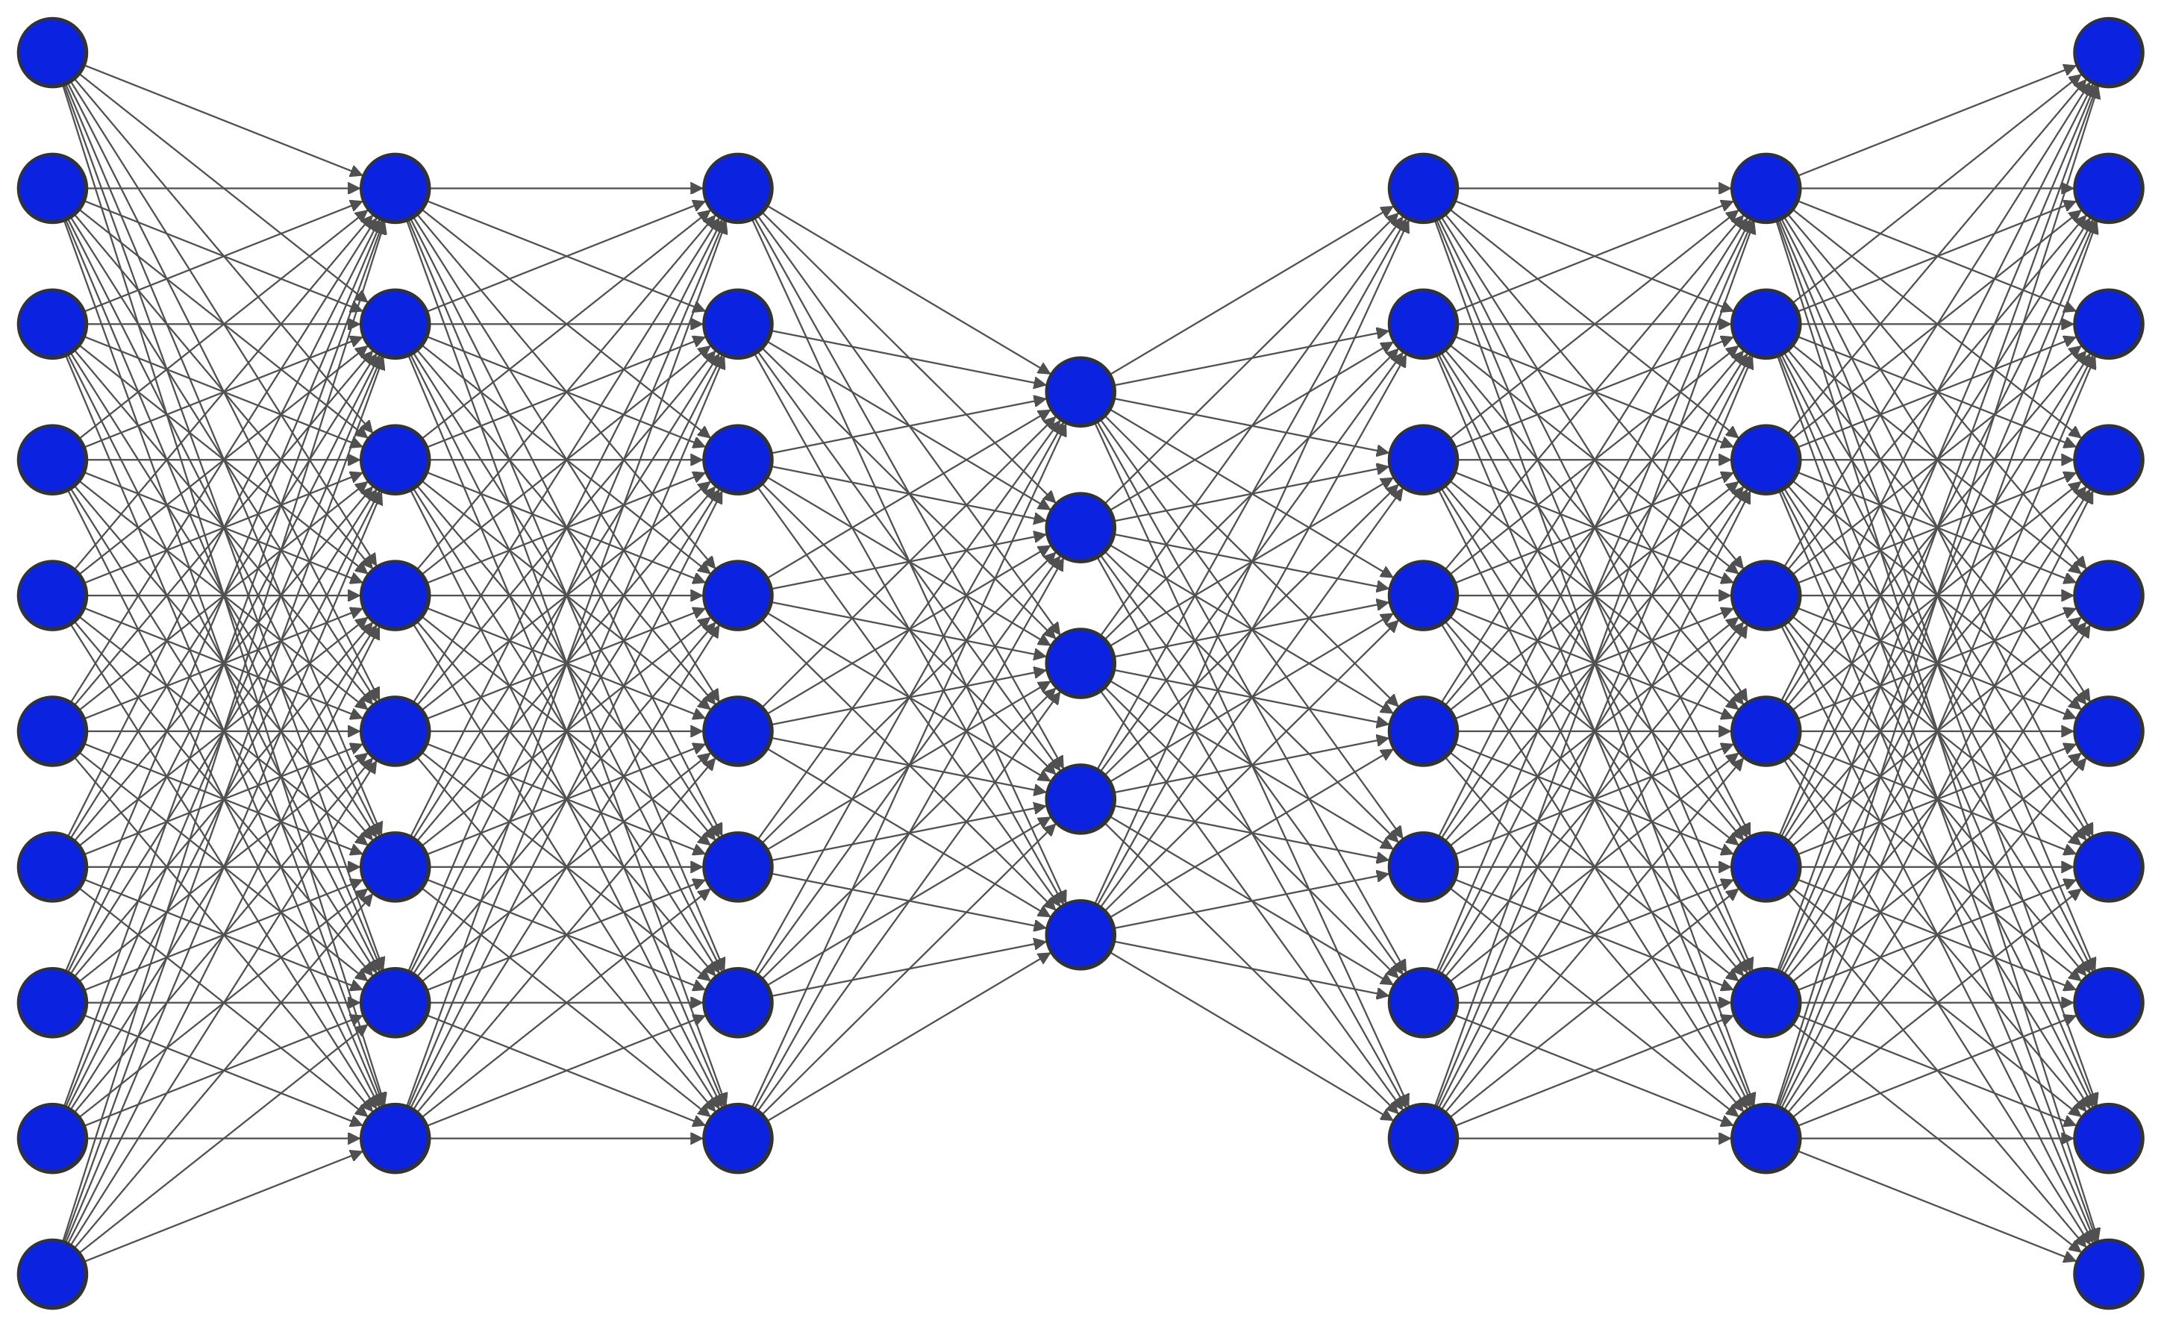
LMSER

Slide 4
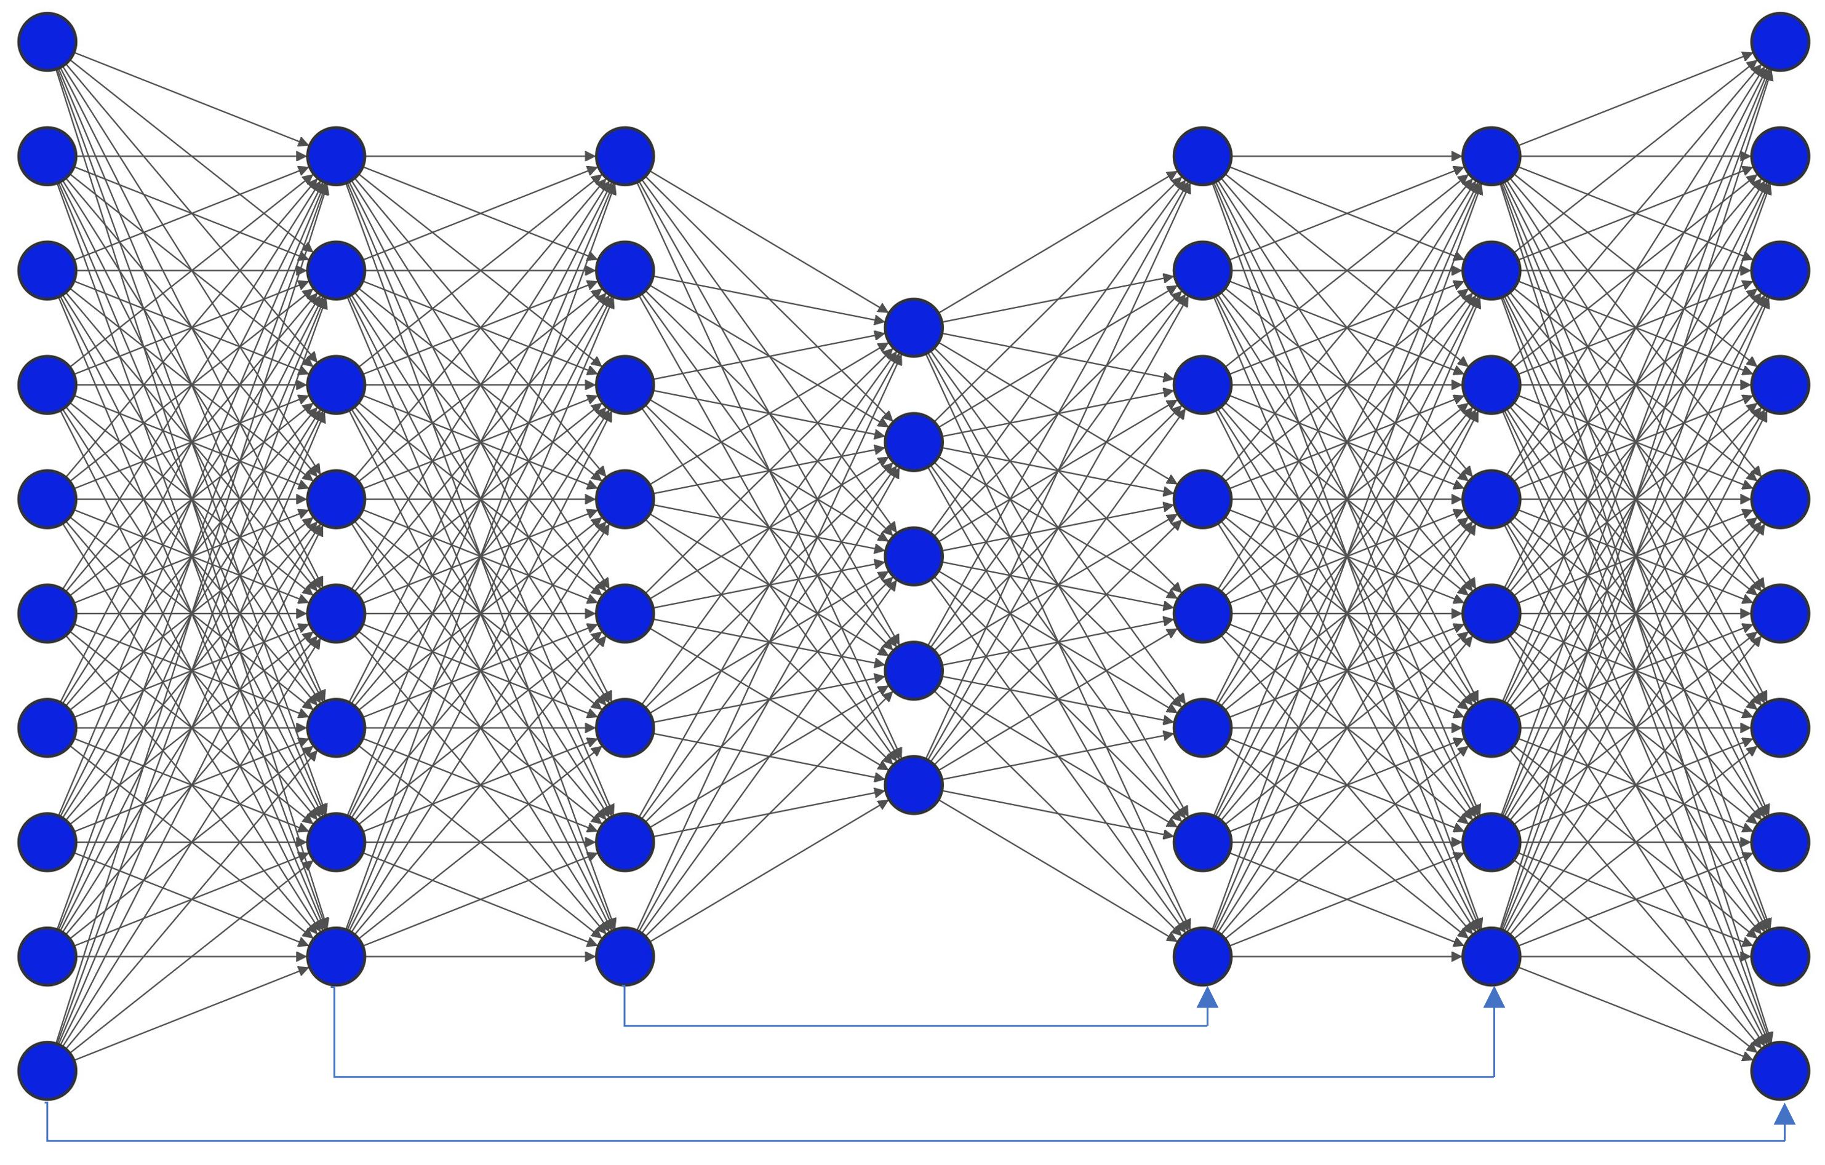
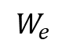
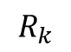
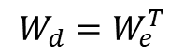
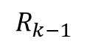
LMSER
$$R_{k−1}$$
recurrent
$$R_{k}$$
shortcut
$$W_{e}$$
$${W_{d}=W}_{e}^{T}$$

Slide 5
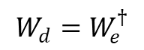

PseInv-LMSER
$$W_{e}$$
$$W_{d}=W_{e}^{†}$$

Slide 6
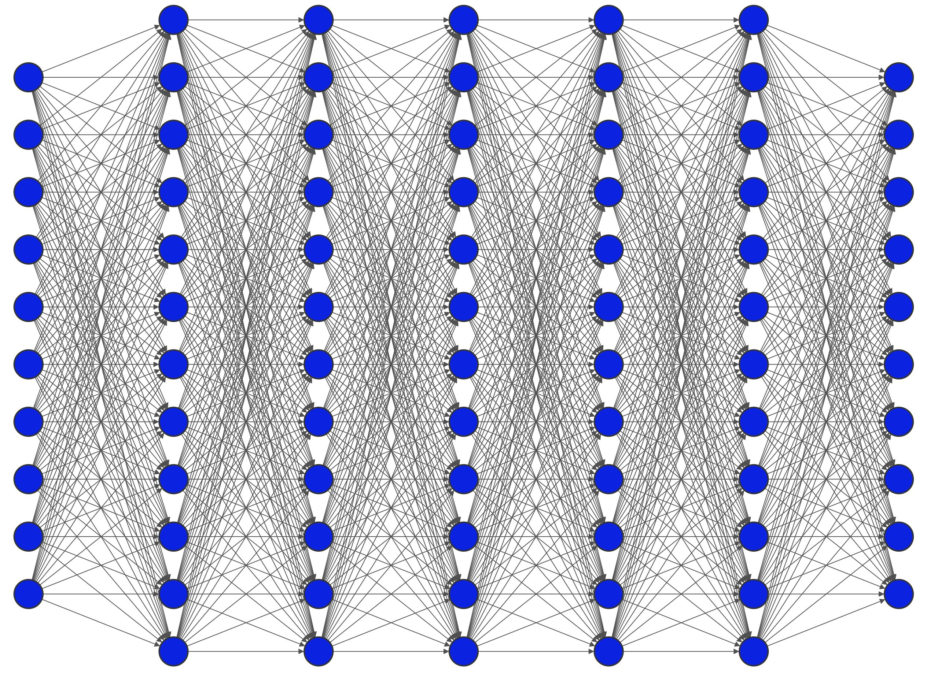
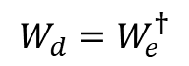

PseInv-LMSER
for perfect reconstruction
$$W_{e}$$
$$W_{d}=W_{e}^{†}$$

Slide 7
Experimental Results

Slide 8
Reconstruction performance
dataset | MNIST | MNIST | MNIST | MNIST | MNIST
model | AE | Lmser (reflect 1) | Lmser (reflect 3) | PseInv Lmser(weak) | PseInv Lmser (strong)
Rec error | 0.227 | 0.116 | 0.131 | 0.403 | 4e-13
dataset | F-MNIST | MNIST | MNIST | MNIST | MNIST
model | AE | Lmser (reflect 1) | Lmser (reflect 3) | PseInv Lmser(weak) | PseInv Lmser (strong)
Rec error | 0.190 | 0.121 | 0.160 | 0.278 | 6e-13

Slide 9
Reconstruction results
Input
AE
Lmser
Reflect=1
Lmser
Reflect=3
PseInv
(weak)
PseInv
(strong)

Slide 10
Reconstruction results
Input
AE
Lmser
Reflect=1
Lmser
Reflect=3
PseInv
(weak)
PseInv
(strong)

Slide 11
Few-shot Reconstruction performance
dataset | MNIST | MNIST | MNIST
model | AE | Lmser (reflect 1) | PseInv Lmser(weak)
5-way 1-shot | 0.60 | 0.40 | 0.44
5-way 5-shot | 0.57 | 0.40 | 0.41
5-way 1-shot
10 epochs
100 batches
1 samples per batch
5 classes per batch
5-way 1-shot
10 epochs
100 batches
1 samples per batch
5 classes per batch
dataset | F-MNIST | MNIST | MNIST
model | AE | Lmser (reflect 1) | PseInv Lmser(weak)
5-way 1-shot | 0.56 | 0.28 | 0.38
5-way 5-shot | 0.54 | 0.27 | 0.32

Slide 12
Reconstruction results
Input
Lmser
Reflect=1
PseInv
(weak)
AE

Slide 13
Classification results
dataset | MNIST | MNIST | MNIST
model | Baseline | Lmser (reflect 1) | Lmser (reflect 3)
Accuracy | 96.42 | 95.35 | 94.99
Rec Error | - | 0.172 | 0.242
dataset | F-MNIST | MNIST | MNIST
model | Baseline | Lmser (reflect 1) | Lmser (reflect 3)
Accuracy | 88.23 | 86.98 | 87.3
Rec Error | - | 0.171 | 0.233

Slide 14
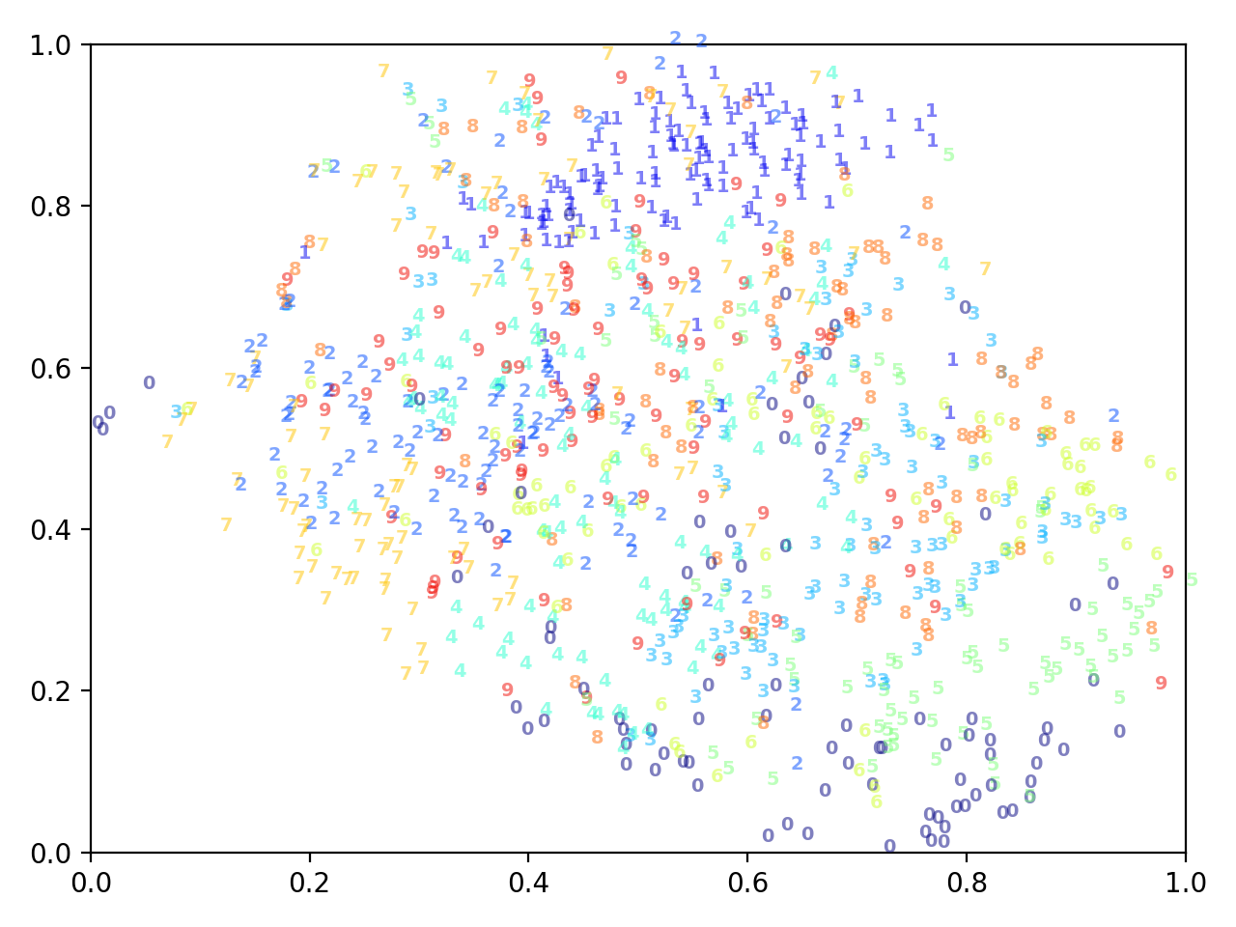
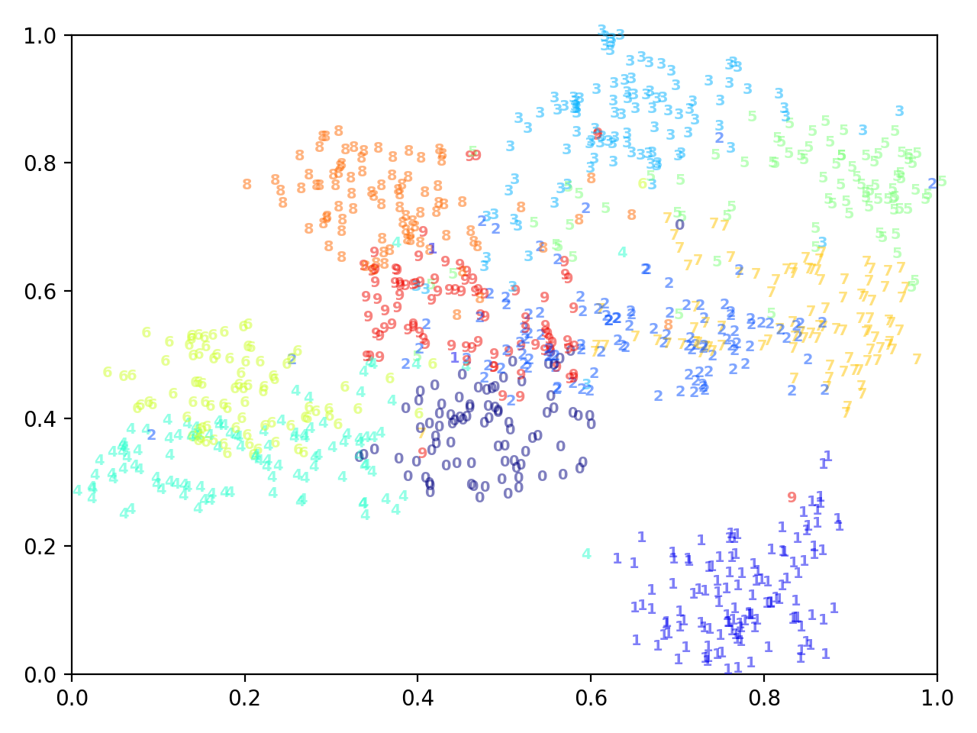
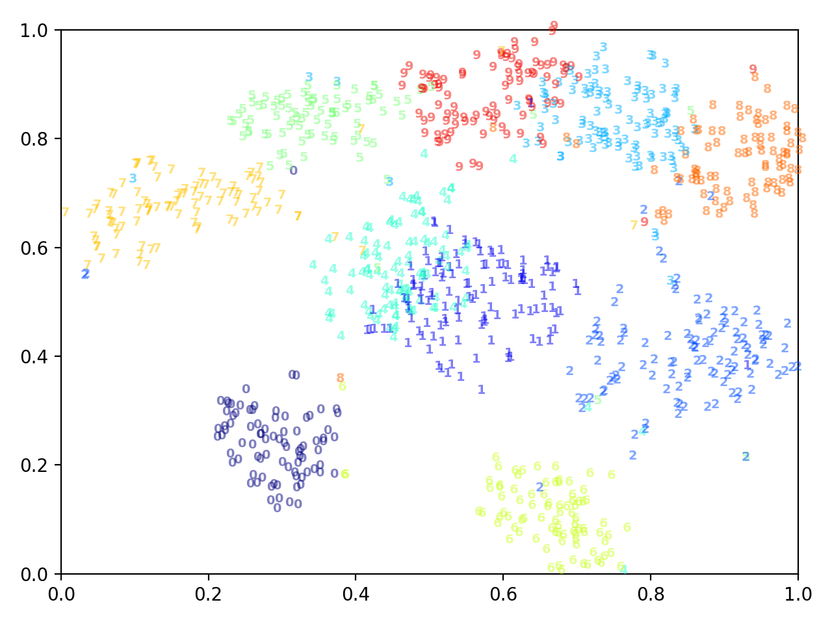
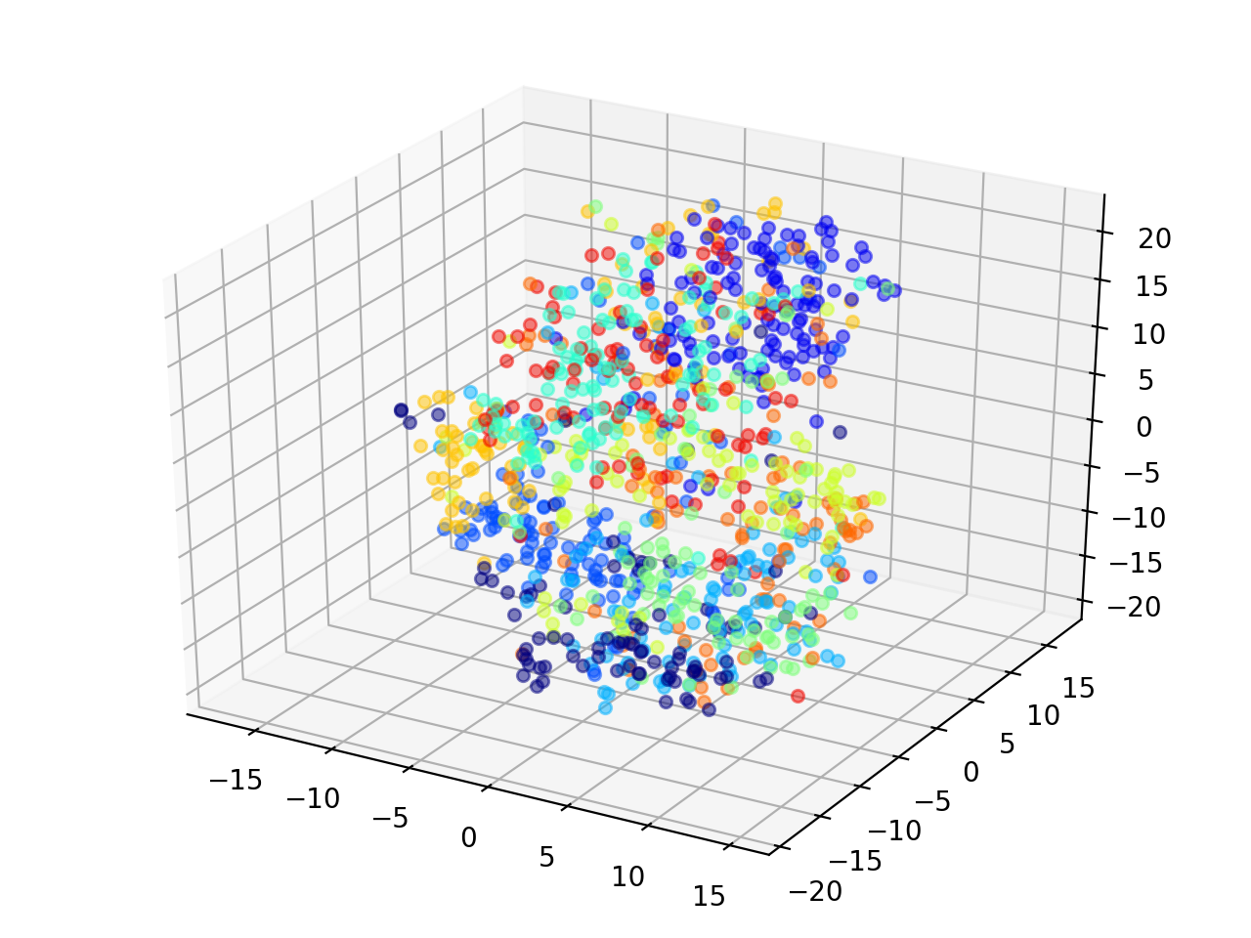
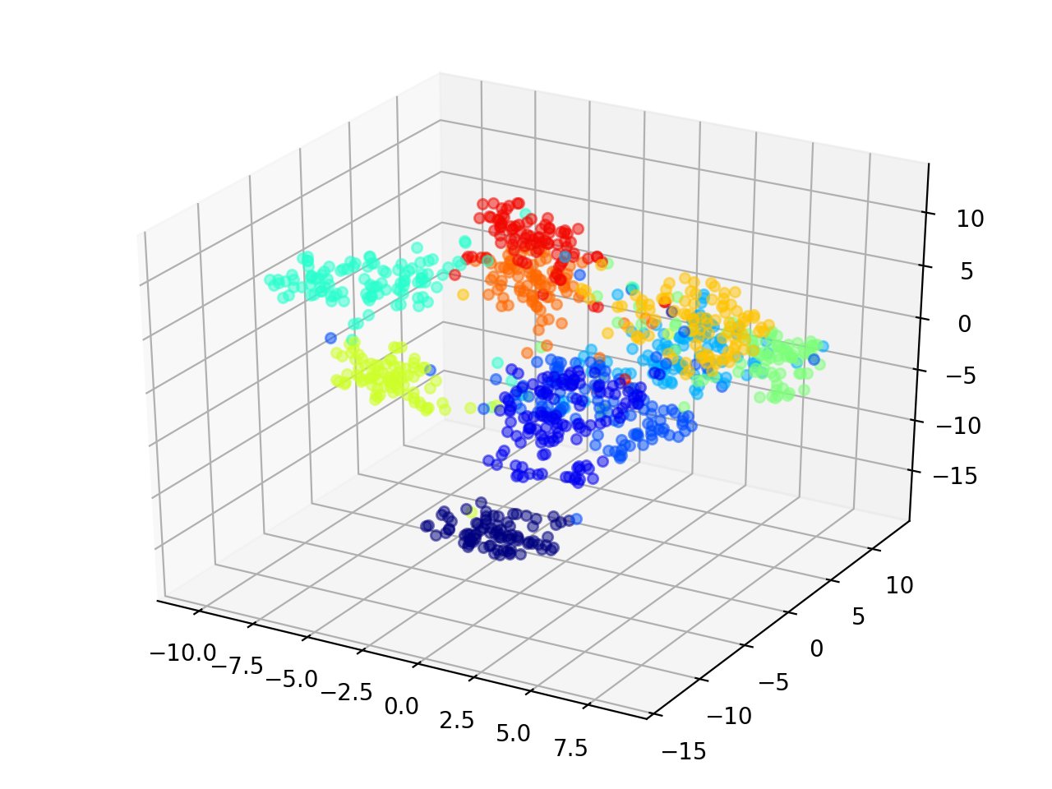
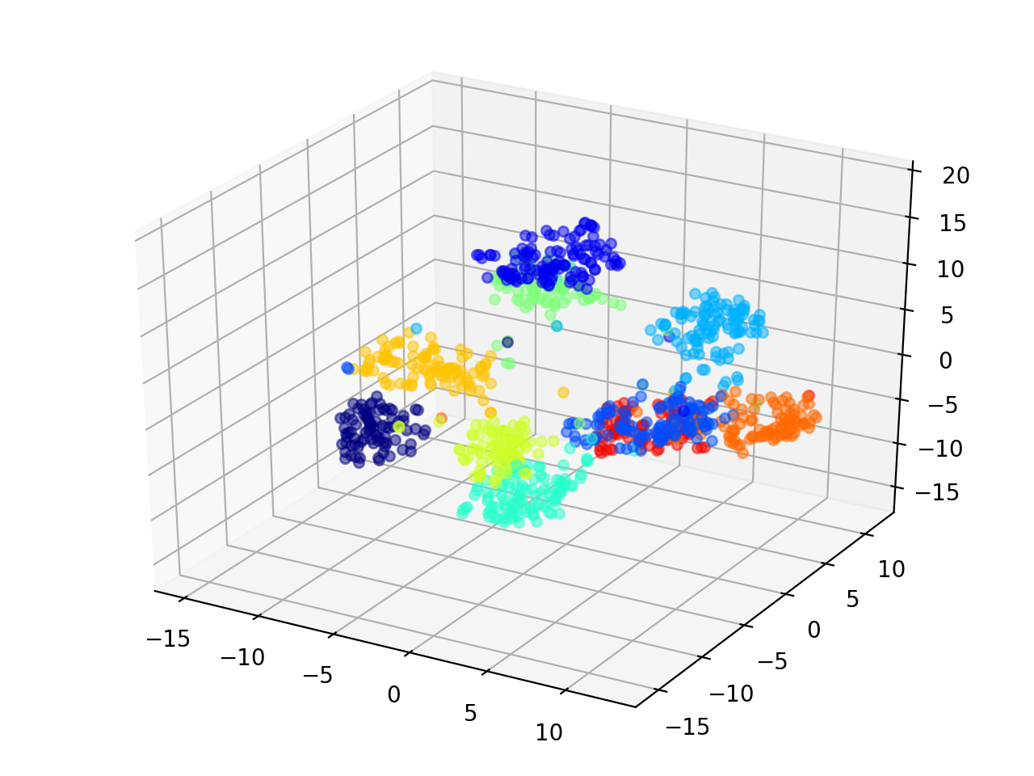
TSNE Visualization: MNIST dataset
Lmser
(no classification)
Lmser
(classification)
Baseline

Slide 15
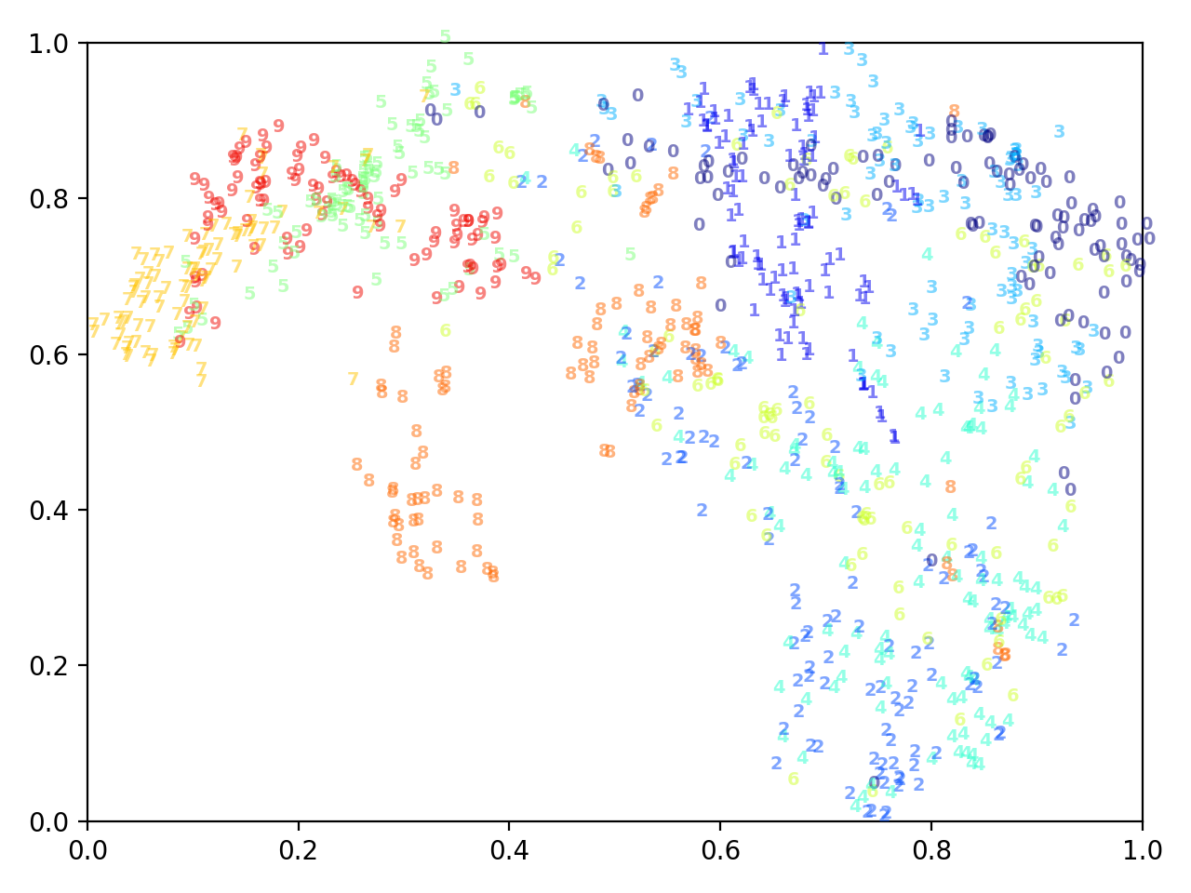
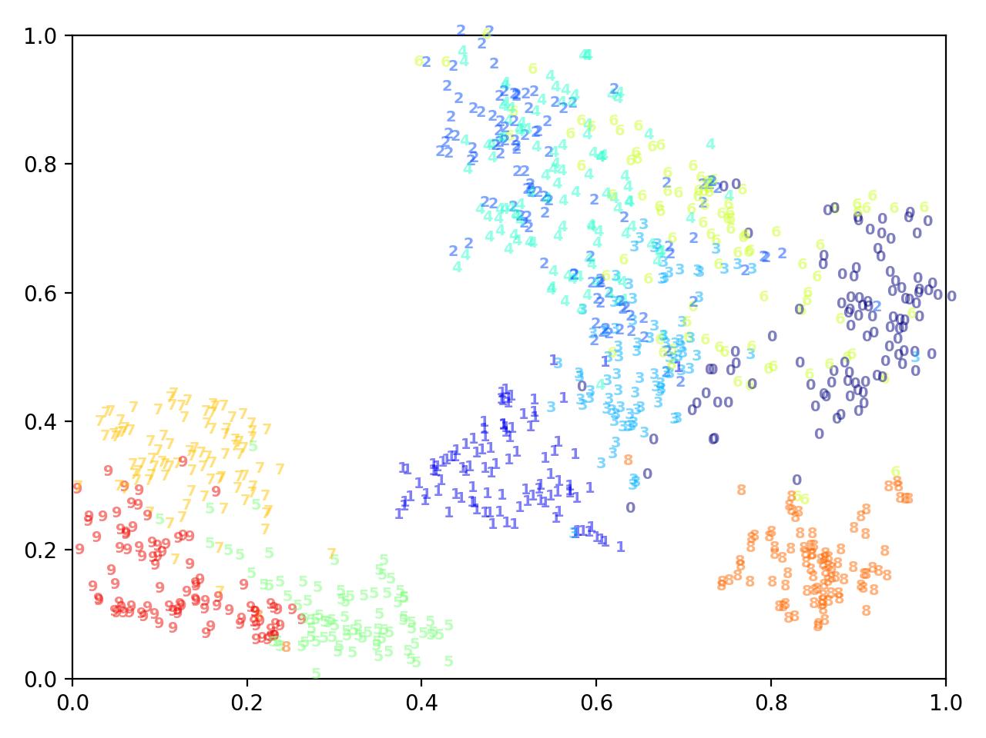
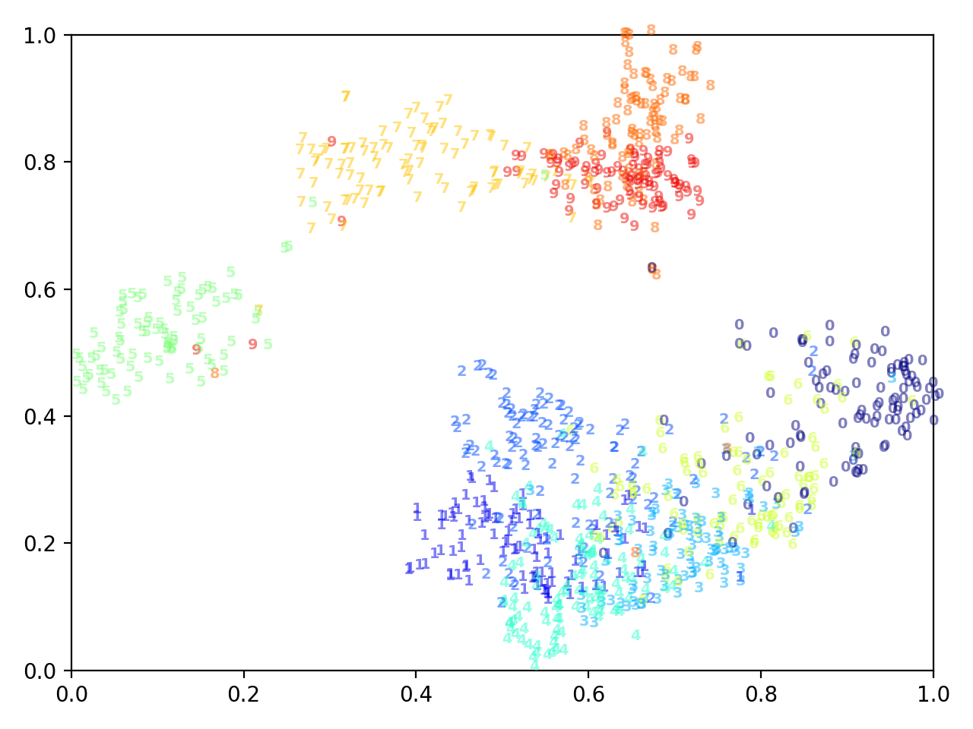
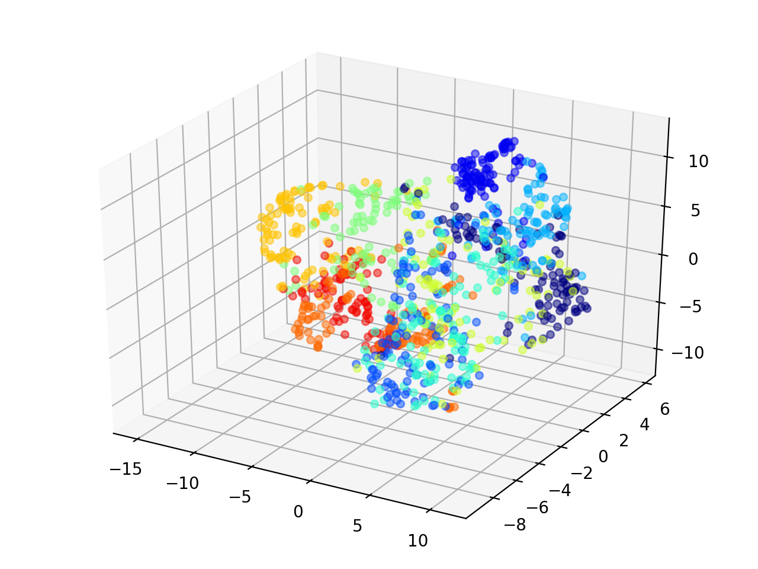
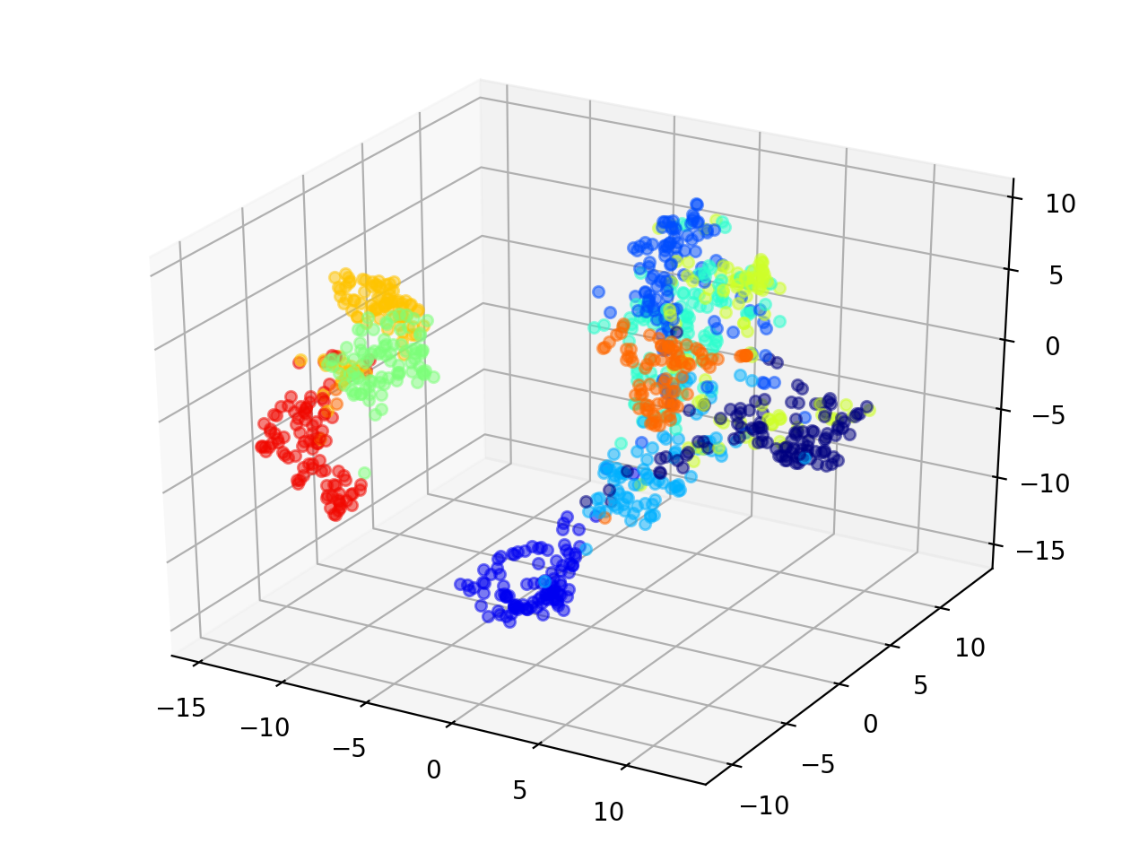
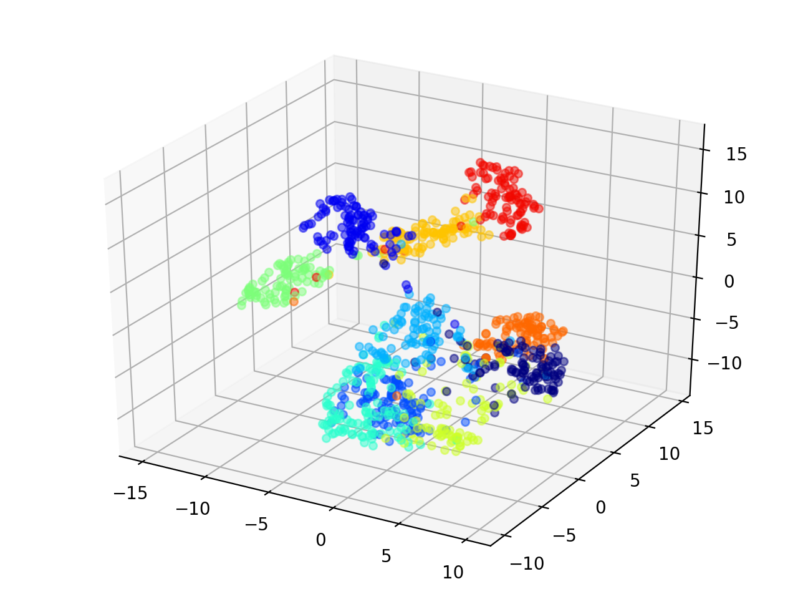
TSNE Visualization: F-MNIST dataset
Lmser
(no classification)
Lmser
(classification)
Baseline

Slide 16
Future work
Classification based on pse-inv lmser
(目前的实验结果并不理想)
Lmser based on CNNs
Test performance in different scenarios, e.g. different layers/channels

Slide 17
Unfold
Thanks!

